Slide 1

XCP: Congestion Control for High Bandwidth-Delay Product Network
Dina Katabi, Mark Handley and Charlie Rohrs
Presented by Ao-Jan Su

Slide 2

Outline
Introduction
XCP: The protocol
Performance vs TCP + RED/CSFQ/REM/AVQ
Conclusion
Notes:
Introduction: Describe of the problem
Design: The rationale behind the design
The protocol: The details of the problem, what it does
Performance: How good is it doing? How does it compare to TCP with different queue management scheme
Deployment: Is it possible to deploy it? How the writer suggest?
Conclusion

Slide 3
Introduction
Future Internet: High bandwidth delay product
  Optical fibers
  Satellite links
TCP performs poor in high bandwidth delay product link
  Unstable: TCP + AQM becomes oscillatory
  Inefficient:
    Addictive increase of 1 pkt/RTT is too slow
    Increase in link capacity doesn’t help short flow → TCP bias against short flow
  Unfair: Throughput inversely proportion RTT → Against high delay
Notes:
Future:
High bandwidth: Today internet increase the bandwidth very fast... From 1.44 → DSL and cable modems, increase faster than CPU.
Delay: Links like Satellite link and wireless WAN/LAN
TCP:
Unstable
Congestion windows change from large to small and then large and then small
Jitter…. Not desirable for application
Introduce lost, as the queue size increase and decrease → hurt seriously to short flow
Underutilization of network, queue sometime empty, sometime full
Addictive increase →
Slow in acquiring spare bandwidth.
Maybe 1000 packet available because bandwidth is high, but then takes 1000 RTT!!
Slowly increase and turn out to be a congestion and then cut by half.
Cannot increase faster than slow start.
Don’t help even bandwidth is available.
Short flow is the major flow in the internet
Throughput is inversely proportion to RTT. Performance against flow using Satellite links and wireless link
Writer introduce XCP:
A congestion control protocol.

Slide 4
Design Goal: Stable + Efficient + Fair
XCP: eXplicit Control Protocol
Better congestion signal
  Packet drop is a poor signal
    Not responsive: have to wait very long for packet loss
    Not precise: Only binary feedback: yes and no
    Not correct: Maybe it is an link error instead of congestion, such as in wireless links
  ECN is not precise
  Generalize ECN, explicit precise feedback
    Increase a lot when a lot is available
    Increase just a little bit when only a little bit is available
Notes:
Resign the congestion control
We want higher efficiency of the link
We want fair, no bias against short flow/ high RTT flow
We stable, no oscillation, not changing all the time
What do we need to do this?
Better signal:
Wait for time out → waste time!!
Better feed back than just yes and no
Don’t want to cut the speed wrongly
ECN (e.g. RED) is a try but we want better
Tell exactly how much
Avoid probing using packets

Slide 5
Decoupling Efficiency & Fairness Control (EC & FC)
  Control theory suggest that congestion control should be independent of number of flow
    TCP congestion control: increase N packets or decrease to 1/N, N is the number of flows
    Congestion control should only deal with aggregate traffic, fairness deals with individual flows
  EC and FC an apply different control law
    MIMD for efficiency, AIMD for fairness
  Flexible: can be modified separately
Notes:
(Control theory: Not using fast changing parameter as signal → The flow number)
TCP’s AIMD make it depends on it.
But actually it is not necessary. TCP does it because of fairness.
Can be separate them so it is not independent of it?
Advantage:
Can apply different rules
MIMD for efficiency → Fill the pipe quickly. Solve congestion quickly
AIMD for fairness, same argument as TCP
Modify fairness controller. Deferential service

Slide 6
Where we are
Introduction
XCP: The protocol
Performance vs TCP + RED/CSFQ/REM/AVQ
Conclusion

Slide 7
XCP: The protocol
After going thru the EC and FC, it finds ok to allow +10 for this flow
After going thru the EC and FC, it allows +5 only
RTT = XXXX
Congestion window = yyyy
Feedback = +10
RTT = XXXX
Congestion window = yyyy
Feedback = +5
RTT = XXXX
Congestion window = yyyy
Feedback = +10
Notes:
Add congestion header to the packet: RTT, cwnd, feedback
Sender fill in RTT, cwnd, initialize feedback with desire bandwidth increase
Router determine allow or not allowing the increase by efficiency and fairness
Each router work independently. If the feedback allow is smaller than the one in the header, modify it
Receiver get the feedback, send it back to the sender
Sender response by changing the rate.

Slide 8
The protocol
Sender
  Fill in the congestion header
Receiver
  Change rate according to feedback
Router
  Compute feedback
  Operate on top of other dropping policy
  Make decision every average RTT
  Efficiency controller and Fairness controller
Notes:
Some addition:
The feedback is base on the link situation
Positive feedback if bandwidth available
Negative feedback if going to exceed capacity
XCP doesn’t drop packet. It is the queuing mechanism does. Drop front/tail.
However, you will see XCP has almost zero drop
The feedback calculation and decision is make every average RTT. Not fast, has to observe the result of the previous decision. No reason for > RTT
The router has 2 component to do this, the EC and FC

Slide 9
Efficiency Controller
Maximize link utilization, minimizing drop rate and persistent queues.
Look at aggregate traffic only, not individual flows
Aggregate feedback φ = α⋅d⋅S - β⋅Q
  α, β constant, d average RTT, S spare bandwidth, Q persistent queue size
Proportional to spare bandwidth
Also want to drain the persistent queue
Notes:
Responsible for Maximizing utilization. Drain the queue to avoid drop
Look at the large picture → The aggregated input traffic, not individual flow.
Explain the variables
Proportion to spare bandwidth
RTT * Spare bandwidth (in terms of size of windows, not bandwidth)
Q is the persistent queue size seen in the interval.
Want to remote the queue also
Persistent Queue introduce jitter and lost

Slide 10
Fairness controller
Convergence to min-max fairness
    If φ > 0, increase all flow with same throughput
    If φ < 0, decrease all flow the same portion of throughput
What if φ = 0? Bandwidth shuffling
    h = max(0, γ⋅y-|φ|)
    γ constant = 0.1, y input traffic
    At least 10% of traffic is redistributed using AIMD
Notes:
We want min-max fairness
Bandwidth evenly distributed to all flow
If a flow doesn’t need that much, evenly distribute the remaining to the others
AIMD converge to fairness.
> 0, same Increase in same throughput, NOT no. of packet in TCP
< 0, same portion of the throughput, NOT fixed to “half”
If = 0
Introduce shuffling. Part of the input traffic is redistributed using the rule.

Slide 11


Per-packet feedback
H_feedback = p_{i} – n_{i}
p_{i} is the positive feedback
n_{i} is the negative feedback
Notes:
How to calculate the increase/decrease?
The rule is different for Increase and different
Calculate separately
We want AD, so… increase in throughput proportional to constant
But the feedback is in window size. And cwnd size = throughput X RTT
The feedback is distributed across all the packets of a flow. So, how many per packet?
The no. of packet in that interval is proportional to
Current window size
Inversely proportion to
Packet size
RTT
Look at the formulary (explain one by one)
All the variables can be get from a single packet
No need to keep per flow state !!

Slide 12
Design features
MIMD for efficiency → Fast response → high utilization
AIMD fairness faster than TCP → converge faster
Achieve so many with NO per flow state
    Only a few multiplication per packet in routers
Not using drop as signal
No complex parameter tuning, stable when
Can change the fairness controller to provide differential services, such as QoS-like services
Notes:
MIMD for efficiency.
Fast because of Precise.
High utilization.
AIMD fairness
Not add 1 packet and by cut half.
In terms of throughput, not packet size, no bias against short flow and large RTT
NO PER FLOW STATE !!!
Achievable by routers. Only several addition and calculation
Not using drop as signal, conform with the idea that
Drop should rarely occur
No need to wait for drop
No parameter tuning like RED or other mechanism.
Flexible FC.
Differential service possible.

Slide 13
Where we are
Introduction
XCP: The protocol
Performance vs TCP + RED/CSFQ/REM/AVQ
Conclusion

Slide 14
Performance
Simulation is done using ns-2
Link capacity from 1.5Mb/s to 4Gb/s
Delay from 10ms to 1.4s
Source from 1 to 1000 and 2 way traffics
Metrics: Utilization, fairness, drop rate, queue size and time to converge
VS. TCP + RED / REM / AVQ / CSFQ
Using single bottleneck topology and a parking lot topology
Notes:
Using ns-2
Large range of situation
Various link capacity/delay/source
Simulation measure different metrics like
Bla bla bla bla
Compare result with TCP
RED → 2 thresholds. Random Early Drop/Detection. Queue upper limit reached. Start drop/mark. Untill lower limit reached. Stop drop/mark
REM → Random early marking. If workload is larger than a value. Mark packet with the probability according to formula depends on W
AVQ → Adaptive virtual queue.
Router maintain a virtual queue. Virtual queue has a smaller capacity and same buffer same as real router.
Update the virtual queue for arrival of every packet
Drop/Mark packet if the virtual queue is overflowed
The virtual capacity is updated every packet arrival
(more aggressive when close to capacity limit)
CSFQ → Border router keep flows state, mark the packet accordingly. Core router drop packets depends on the marking and current link state. Remark the packet after drop. Want to maintain fairness.
ISI has implemented XCP in FreeBSD. Experiment shows similar results as the simulation

Slide 15
ACTIVE QUEUE MANAGEMENT
Algorithms used to identify packets to drop or mark are called ACTIVE QUEUE MANAGEMENT (AQM) schemes
  Random Early Discard/Detection (RED) drops packets with probability according to its average queue length
  Random Early/Exponential Marking (REM) marks packets with probability according to its queue length and the marks will be carried back by ACKs
  Adaptive Virtual Queue (AVQ) computes virtual capacity used by the router to drop or mark a real packet depending on congestion notification
  Core Stateless Fair Queuing (CSFQ): Core routers do not need to perform per flow management, instead, edge routers do the flow classification.

Slide 16
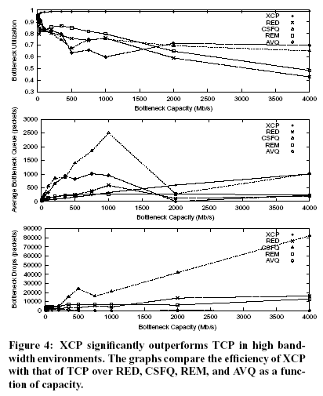

Slide 17
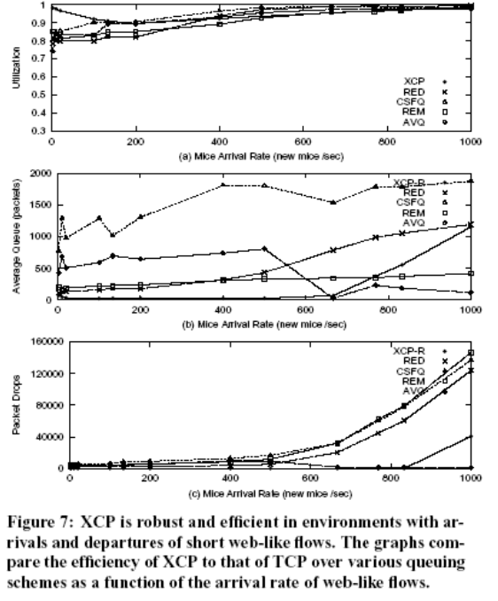

Slide 18
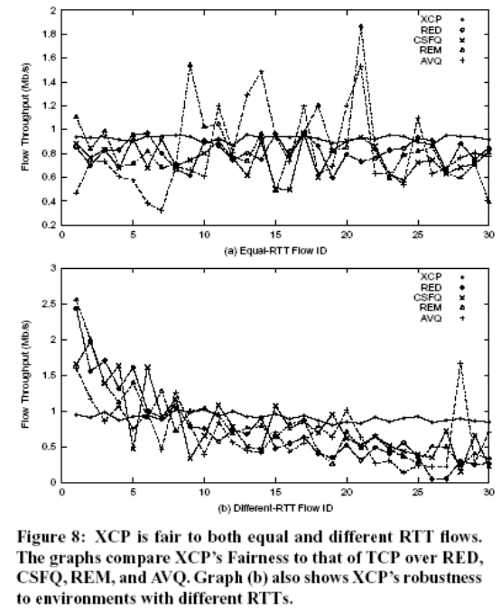

Slide 19
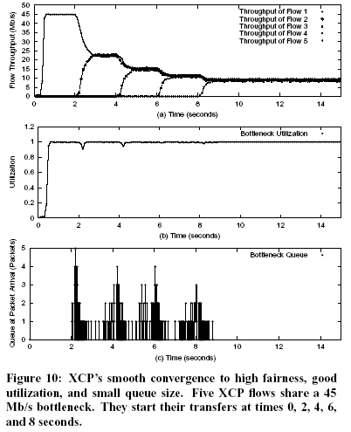

Slide 20
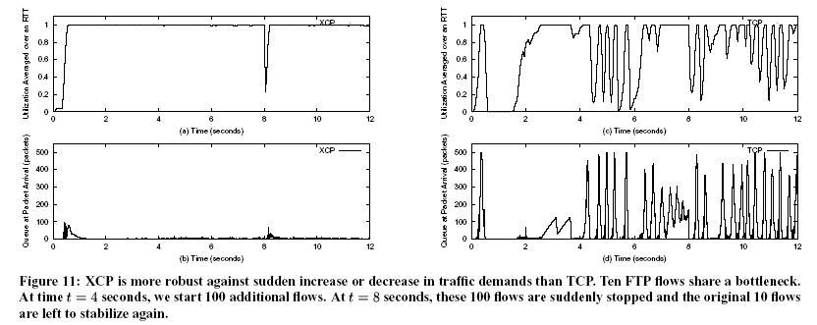

Slide 21
Performance overview
High utilization – close to bottleneck bandwidth
Fast converging to fair bandwidth and optimal utilization
Very fair among flows
Almost no packet drop
Small queue
Stable

Slide 22
Where we are
Introduction
Design
XCP: The protocol
  Header
  Sender & receiver
  Router: Efficiency & Fairness controller
Performance vs TCP + RED/CSFQ/REM/AVQ
Deployment
Conclusion

Slide 23
Deployment
2 suggested graduate deployment
  XCP-based Core Stateless Fair Queuing
  Mapping TCP/UDP flow into XCP flow in ingress and egress border routers. Each XCP flow associated with a queue at ingress router and determine when they can leave using as if using XCP.
  A TCP-friendly XCP
  Check if receiver and routers along the path support XCP. Separate TCP and XCP queue. Router responsible for making sure the throughput is fair. Can be done by dynamic weighted-fair queuing.
Notes:
Both need changes in routers
Incentive? ISP acceptable?

Slide 24
Conclusion
XCP: a new congestion control protocol/framework
Achieve high utilization by explicit feedback
Separating Efficiency and Fairness control provides flexibility
Stable, fair and efficient

Slide 25
Thank you!

